Slide 1
English lesson
It is very easy

Slide 6
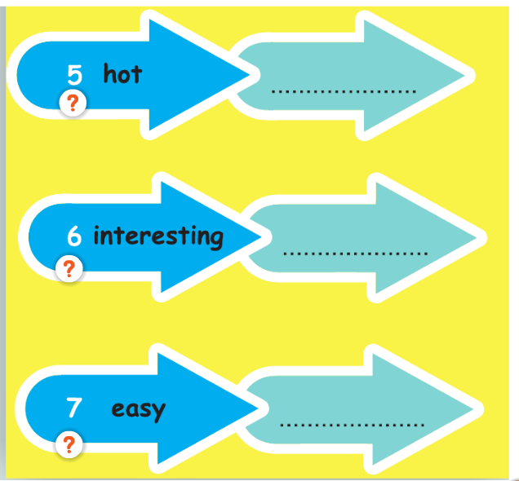

Slide 7
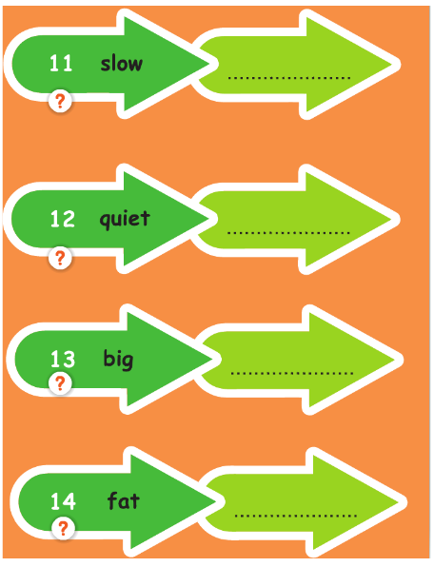

Slide 14
